Slide 1
CE 395R 5- Data Mining Mining Complex Types of Data

Slide 2
Mining Complex Types of Data
Mining spatial databases
Mining multimedia databases
Mining time-series and sequence data
Mining text databases
Mining the World-Wide Web
Graph Mining
Social network Analysis

Slide 3
Spatial Data
Spatial data integration: a big issue
Structure-specific formats (raster- vs. vector-based, OO vs. relational databases, different storage and indexing, etc.)
Vendor-specific formats (ESRI, MapInfo, Integraph, IDRISI, etc.)
Geo-specific formats (geographic vs. equal area projection, etc.)
Map Analysis

Slide 4
Example: British Columbia Weather Pattern Analysis
Input
A map with about 3,000 weather probes scattered in B.C.
Daily data for temperature, precipitation, wind velocity, etc.
Output
A map that reveals patterns: merged (similar) regions
Goals
Interactive analysis
Fast response time
Minimizing storage space used
Challenge
A merged region may contain hundreds of “primitive” regions (polygons)

Slide 5
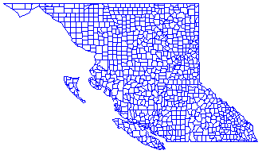
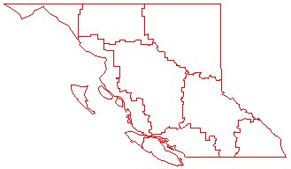
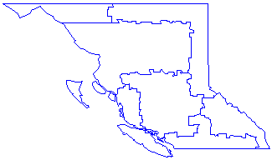
Dynamic Merging of Spatial Objects

Slide 6
Spatial Classification
Analyze spatial objects to derive classification schemes in relevance to certain spatial properties (district, highway, river, etc.)
Employ most of the classification methods
Decision-tree classification, Naïve-Bayesian classifier, neural network, etc.
Association-based multi-dimensional classification - Example: classifying house value based on proximity to lakes, highways, mountains, etc.

Slide 7
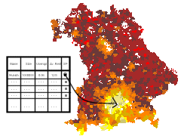
Spatial Trend Analysis
Spatial Data Mining at Univesity of Munich
Function
Detect changes and trends along a spatial dimension
Study the trend of non-spatial or spatial data changing with space
Application examples
Observe the trend of changes of the climate or vegetation with increasing distance from an ocean
Crime rate or unemployment rate change with regard to city geo-distribution
Farm Insurance Frauds ( from NPR ; USDA )

Slide 8
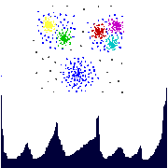
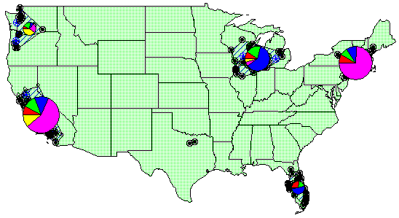
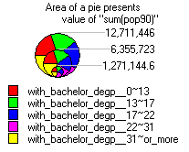
Spatial Cluster Analysis
Mining clusters—k-means, k-medoids, hierarchical, density-based, etc.
Analysis of distinct features of the clusters

Slide 9
Mining Complex Types of Data
Mining spatial databases
Mining multimedia databases
Mining time-series and sequence data
Mining text databases
Mining the World-Wide Web
Graph Mining
Social network Analysis

Slide 10
Queries in Content-Based Retrieval Systems
Image sample-based queries
Find all of the images that are similar to the given image sample
Compare the feature vector (signature) extracted from the sample with the feature vectors of images that have already been extracted and indexed in the image database
Image feature specification queries
Specify or sketch image features like color, texture, or shape, which are translated into a feature vector
Match the feature vector with the feature vectors of the images in the database

Slide 11


Mining Multimedia Databases
Search for “airplane in blue sky”
Search for “blue sky”
Multimedia Mining Research

Slide 12
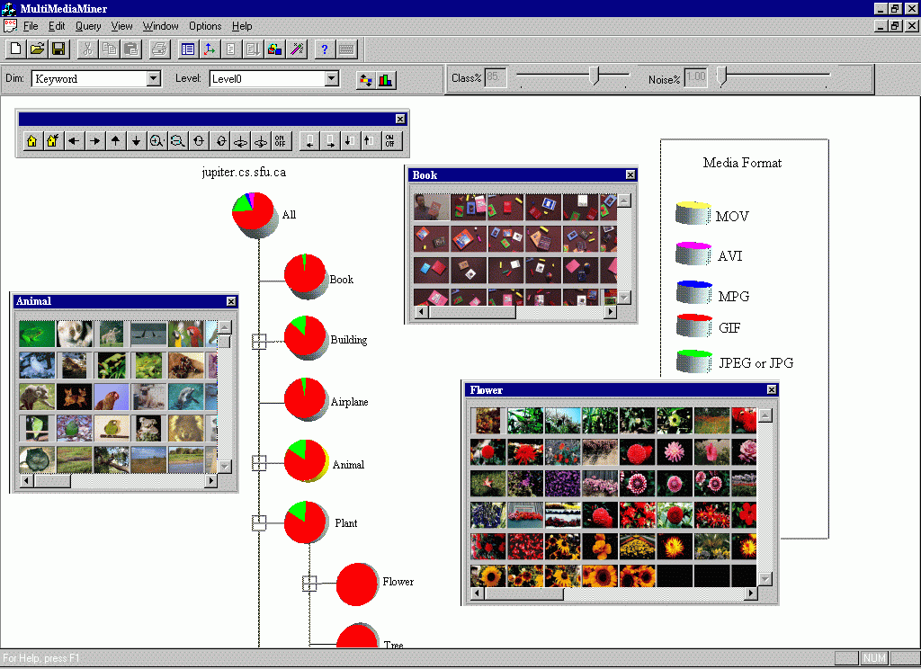
Classification in MultiMediaMiner

Slide 13
Mining Complex Types of Data
Mining spatial databases
Mining multimedia databases
Mining time-series and sequence data
Mining text databases
Mining the World-Wide Web
Graph Mining
Social network Analysis

Slide 14
Mining Time-Series and Sequence Data
Time-series database
Consists of sequences of values or events changing with time
Data is recorded at regular intervals
Characteristic time-series components
Trend, cycle, seasonal, irregular
Applications
Financial: stock price, inflation
Biomedical: blood pressure
Meteorological: precipitation

Slide 15
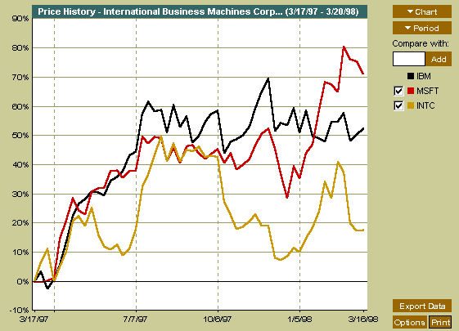
Mining Time-Series and Sequence Data
Time-series plot

Slide 16
Mining Time-Series and Sequence Data: Trend analysis
A time series can be illustrated as a time-series graph which describes a point moving with the passage of time
Categories of Time-Series Movements
Long-term or trend movements (trend curve)
Cyclic movements or cycle variations, e.g., business cycles
Seasonal movements or seasonal variations
i.e, almost identical patterns that a time series appears to follow during corresponding months of successive years.
Irregular or random movements

Slide 17
Mining Complex Types of Data
Mining spatial databases
Mining multimedia databases
Mining time-series and sequence data
Mining text databases
Mining the World-Wide Web
Graph Mining
Social network Analysis

Slide 18
Text Databases and IR
Text databases (document databases)
Large collections of documents from various sources: news articles, research papers, books, digital libraries, e-mail messages, and Web pages, library database, etc.
Data stored is usually semi-structured
Traditional information retrieval techniques become inadequate for the increasingly vast amounts of text data
Information retrieval
A field developed in parallel with database systems
Information is organized into (a large number of) documents
Information retrieval problem: locating relevant documents based on user input, such as keywords or example documents

Slide 19
Information Retrieval Techniques(1)
Basic Concepts
A document can be described by a set of representative keywords called index terms.
Different index terms have varying relevance when used to describe document contents.
This effect is captured through the assignment of numerical weights to each index term of a document. (e.g.: frequency, tf-idf)
DBMS Analogy
Index Terms → Attributes
Weights → Attribute Values

Slide 20
Information Retrieval Techniques(2)
Information Retrieval Models:
Boolean Model
Vector Model
Probabilistic Model

Slide 21
Boolean Model
Consider that index terms are either present or absent in a document
As a result, the index term weights are assumed to be all binaries
A query is composed of index terms linked by three connectives: not, and, and or
e.g.: car and repair, plane or airplane
The Boolean model predicts that each document is either relevant or non-relevant based on the match of a document to the query

Slide 22
Boolean Model: Keyword-Based Retrieval
A document can be identified by a set of keywords
Queries may use expressions of keywords
E.g., car and repair shop, tea or coffee, DBMS but not Oracle
Queries and retrieval should consider synonyms, e.g., repair and maintenance
Major difficulties of the model
Synonymy: multiple words with the same meaning.
e.g., elevator and lift
Polysemy: words that have multiple meanings.
E.g.: door

Slide 23
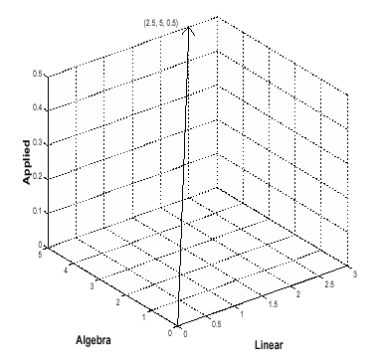
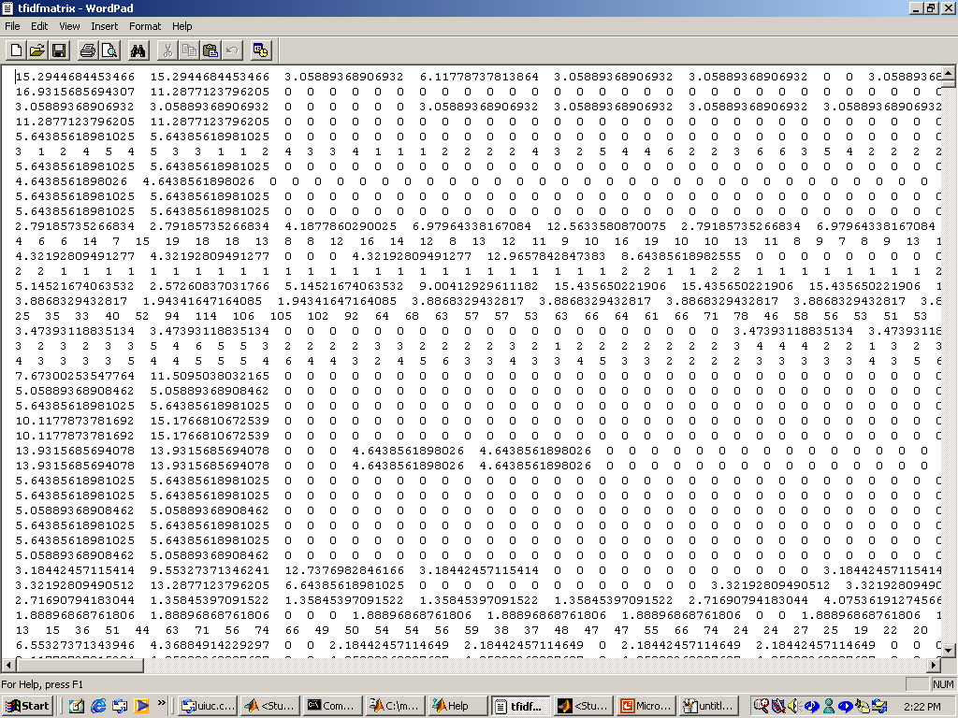
Vector Model
Documents and user queries are represented as m-dimensional vectors, where m is the total number of index terms in the document collection.
The degree of similarity of the document d with regard to the query q is calculated as the correlation between the vectors that represent them, using measures such as the Euclidian distance or the cosine of the angle between these two vectors.

Slide 24
Similarity-Based Retrieval in Text Databases
Finds similar documents based on a set of common keywords
Answer should be based on the degree of relevance based on the nearness of the keywords, relative frequency of the keywords, etc.
Basic techniques
Stop list
Set of words that are deemed “irrelevant”, even though they may appear frequently
E.g., a, the, of, for, to, with, etc.

Slide 25
Similarity-Based Retrieval in Text Databases (2)
Word stem
Several words are small syntactic variants of each other since they share a common word stem
E.g., drug, drugs, drugged
A term frequency table
Each entry frequent_table(i, j) = # of occurrences of the word t_{i} in document d_{i}
Usually, the ratio instead of the absolute number of occurrences is used
Similarity metrics: measure the closeness of a document to a query (a set of keywords)
Euclidian distance
Cosine distance:

Slide 26
Types of Text Data Mining
Keyword-based association analysis
Automatic document classification
Similarity detection
Cluster documents by a common author
Cluster documents containing information from a common source
Link analysis: unusual correlation between entities
Sequence analysis: predicting a recurring event
Anomaly detection: find information that violates usual patterns
Hypertext analysis
Patterns in anchors/links
Anchor text correlations with linked objects

Slide 27
Text Classification(1)
Motivation
Automatic classification for the large number of on-line text documents (Web pages, e-mails, corporate intranets, etc.)
Classification Process
Data preprocessing
Definition of training set and test sets
Creation of the classification model using the selected classification algorithm
Classification model validation
Classification of new/unknown text documents
Text document classification differs from the classification of relational data
Document databases are not structured according to attribute-value pairs

Slide 28
Text Classification(2)
Classification Algorithms:
Support Vector Machines
K-Nearest Neighbors
Naïve Bayes
Neural Networks
Decision Trees
Association rule-based
Boosting

Slide 29
Document Clustering
Motivation
Automatically group related documents based on their contents
No predetermined training sets or taxonomies
Generate a taxonomy at runtime
Clustering Process
Data preprocessing: remove stop words, stem, feature extraction, lexical analysis, etc.
Hierarchical clustering: compute similarities applying clustering algorithms.
Model-Based clustering (Neural Network Approach): clusters are represented by “exemplars”. (e.g.: SOM)

Slide 30
Mining Complex Types of Data
Mining spatial databases
Mining multimedia databases
Mining time-series and sequence data
Mining text databases
Mining the World-Wide Web
Graph Mining
Social network Analysis

Slide 31
Mining the World-Wide Web
The WWW is huge, widely distributed, global information service center for:
Information services: news, advertisements, consumer information, financial management, education, government, e-commerce, etc.
Hyper-link information
Access and usage information
WWW provides rich sources for data mining
Challenges
Too huge for effective data warehousing and data mining
Too complex and heterogeneous: no standards and structure

Slide 32
Mining the World-Wide Web
Growing and changing very rapidly
Broad diversity of user communities
Only a small portion of the information on the Web is truly relevant or useful
99% of the Web information is useless to 99% of Web users
How can we find high-quality Web pages on a specified topic?

Slide 33
Web search engines
Index-based: search the Web, index Web pages, and build and store huge keyword-based indices
Help locate sets of Web pages containing certain keywords
Deficiencies
A topic of any breadth may easily contain hundreds of thousands of documents
Many documents that are highly relevant to a topic may not contain keywords defining them

Slide 34
Web Mining: A more challenging task
Searches for
Web access patterns
Web structures
Regularity and dynamics of Web contents
Problems
The “abundance” problem
Limited coverage of the Web: hidden Web sources, majority of data in DBMS
Limited query interface based on keyword-oriented search
Limited customization to individual users

Slide 35
Web Mining Taxonomy
Web Mining
Web Content
Mining
Web Structure
Mining
Web Usage
Mining
Web Page
Content Mining
Search Result
Mining
General Access
Pattern Tracking
Customized
Usage Tracking

Slide 36
Mining the World-Wide Web
Web Mining
Web Content
Mining
Web Structure
Mining
Web Usage
Mining
Web Page Content Mining
Web Page Summarization
WebLog (Lakshmanan et.al. 1996), WebOQL(Mendelzon et.al. 1998) …:
Web Structuring query languages;
Can identify information within given web pages
Ahoy! (Etzioni et.al. 1997):Uses heuristics to distinguish personal home pages from other web pages
ShopBot (Etzioni et.al. 1997): Looks for product prices within web pages
Search Result
Mining
General Access
Pattern Tracking
Customized
Usage Tracking

Slide 37
Mining the World-Wide Web
Web Mining
Web Content
Mining
Web Structure
Mining
Web Usage
Mining
Web Page
Content Mining
Search Result Mining
Search Engine Result Summarization
Clustering Search Result (Leouski and Croft, 1996, Zamir and Etzioni, 1997):
Categorizes documents using phrases in titles and snippets
General Access
Pattern Tracking
Customized
Usage Tracking

Slide 38
Mining the World-Wide Web
Web Mining
Web Content
Mining
Web Usage
Mining
Web Structure Mining
Using Links
PageRank (Brin et al., 1998)
CLEVER (Chakrabarti et al., 1998)
Use interconnections between web pages to give weight to pages.
Using Generalization
MLDB (1994), VWV (1998)
Uses a multi-level database representation of the Web. Counters (popularity) and link lists are used for capturing structure.
Search Result
Mining
General Access
Pattern Tracking
Web Page
Content Mining
Customized
Usage Tracking

Slide 39
Mining the World-Wide Web
Web Mining
Web Content
Mining
Web Structure
Mining
Web Usage
Mining
Web Page
Content Mining
General Access Pattern Tracking
Web Log Mining (Zaïane, Xin and Han, 1998)
Uses KDD techniques to understand general access patterns and trends.
Can shed light on better structure and grouping of resource providers.
Customized
Usage Tracking
Search Result
Mining

Slide 40
Mining the World-Wide Web
Web Mining
Web Content
Mining
Web Structure
Mining
Web Usage
Mining
Web Page
Content Mining
General Access
Pattern Tracking
Customized Usage Tracking
Adaptive Sites (Perkowitz and Etzioni, 1997)
Analyzes access patterns of each user at a time.
Web site restructures itself automatically by learning from user access patterns.
Search Result
Mining

Slide 41
Mining the Web's Link Structures
Problems with the Web linkage structure
Not every hyperlink represents an endorsement
Other purposes are for navigation or for paid advertisements
If the majority of hyperlinks are for endorsement, the collective opinion will still dominate
One authority will seldom have its Web page point to its rival authorities in the same field
Authoritative pages are seldom particularly descriptive
Hub
Set of Web pages that provides collections of links to authorities

Slide 42
Web Usage Mining
Mining Web log records to discover user access patterns of Web pages
Applications
Target potential customers for electronic commerce
Enhance the quality and delivery of Internet information services to the end user
Improve Web server system performance
Identify potential prime advertisement locations
Web logs provide rich information about Web dynamics
Typical Web log entry includes the URL requested, the IP address from which the request originated, and a timestamp

Slide 43
Mining Complex Types of Data
Mining spatial databases
Mining multimedia databases
Mining time-series and sequence data
Mining text databases
Mining the World-Wide Web
Graph Mining
Social network Analysis

Slide 44
Why Graph Mining?
Graphs are ubiquitous
Chemical compounds (Cheminformatics)
Protein structures, biological pathways/networks (Bioinformactics)
Program control flow, traffic flow, and workflow analysis
XML databases, Web, and social network analysis
Graph is a general model
Trees, lattices, sequences, and items are degenerated graphs
Diversity of graphs
Directed vs. undirected, labeled vs. unlabeled (edges & vertices), weighted, with angles & geometry (topological vs. 2-D/3-D)
Complexity of algorithms: many problems are of high complexity

Slide 45
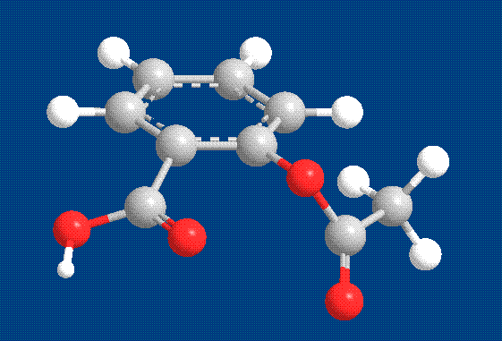
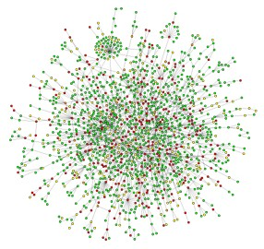
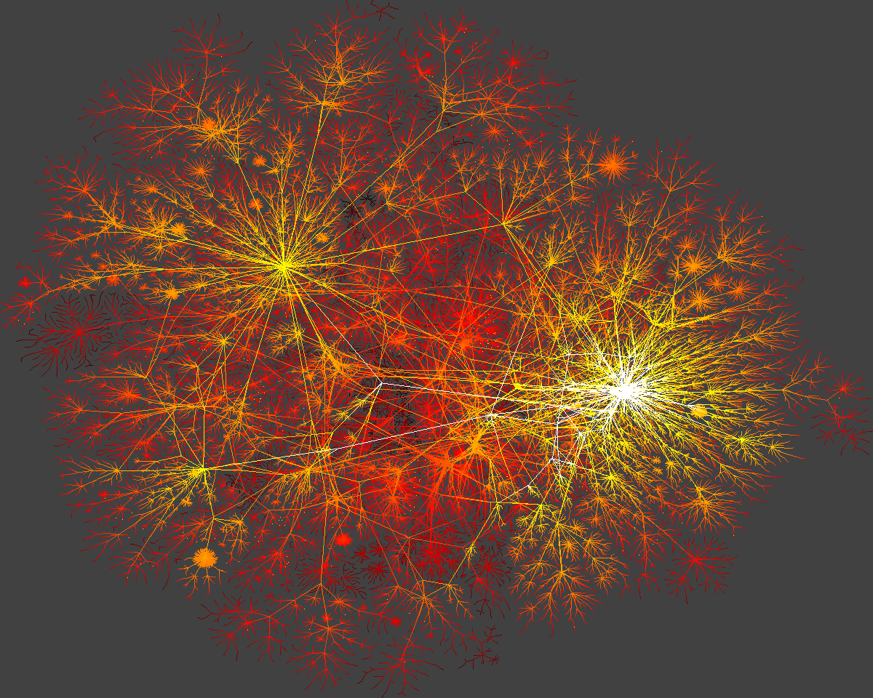
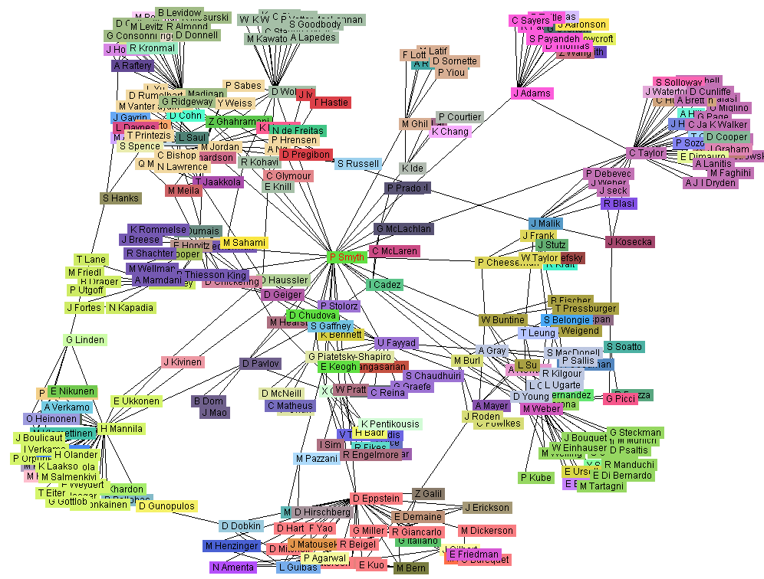
Graph, Graph, Everywhere
from H. Jeong et al Nature 411, 41 (2001)
Aspirin
Yeast protein interaction network
Internet
Co-author network

Slide 46
Graph Pattern Mining
Frequent subgraphs
A (sub)graph is frequent if its support (occurrence frequency) in a given dataset is no less than a minimum support threshold
Applications of graph pattern mining
Mining biochemical structures
Program control flow analysis
Mining XML structures or Web communities
Building blocks for graph classification, clustering, compression, comparison, and correlation analysis

Slide 47
Example: Frequent Subgraphs
GRAPH DATASET
(A)
(B)
(C)
FREQUENT PATTERNS
(MIN SUPPORT IS 2)
(1)
(2)

Slide 48
EXAMPLE (II)
GRAPH DATASET
FREQUENT PATTERNS
(MIN SUPPORT IS 2)

Slide 49
Graph Mining Algorithms
Incomplete beam search – Greedy (Subdue)
Inductive logic programming (WARMR)
Graph theory-based approaches
Apriori-based approach
Pattern-growth approach

Slide 50
Mining Complex Types of Data
Mining spatial databases
Mining multimedia databases
Mining time-series and sequence data
Mining text databases
Mining the World-Wide Web
Graph Mining
Social network Analysis

Slide 51
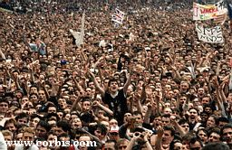
Society
Nodes: individuals
Links: social relationship (family/work/friendship/etc.)
Social networks: Many individuals with diverse social interactions between them.
Social Media Mining

Slide 52
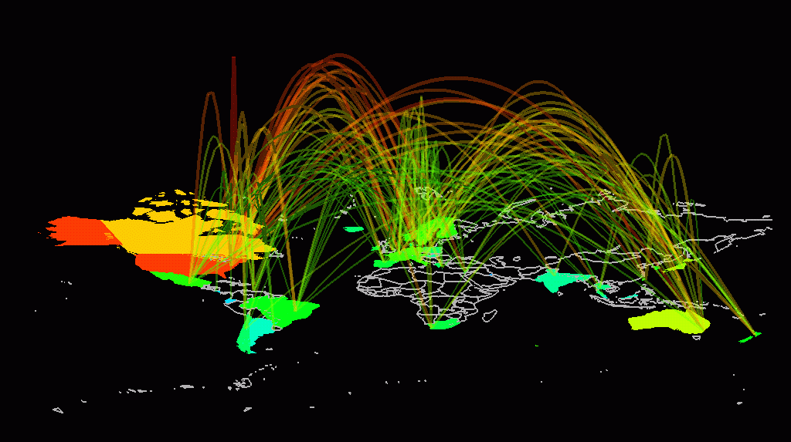
Communication networks
The Earth is developing an electronic nervous system, a network with diverse nodes and links are
-computers
-routers
-satellites
-phone lines
-TV cables
-EM waves
Communication networks: Many non-identical components with diverse connections between them.

Slide 53
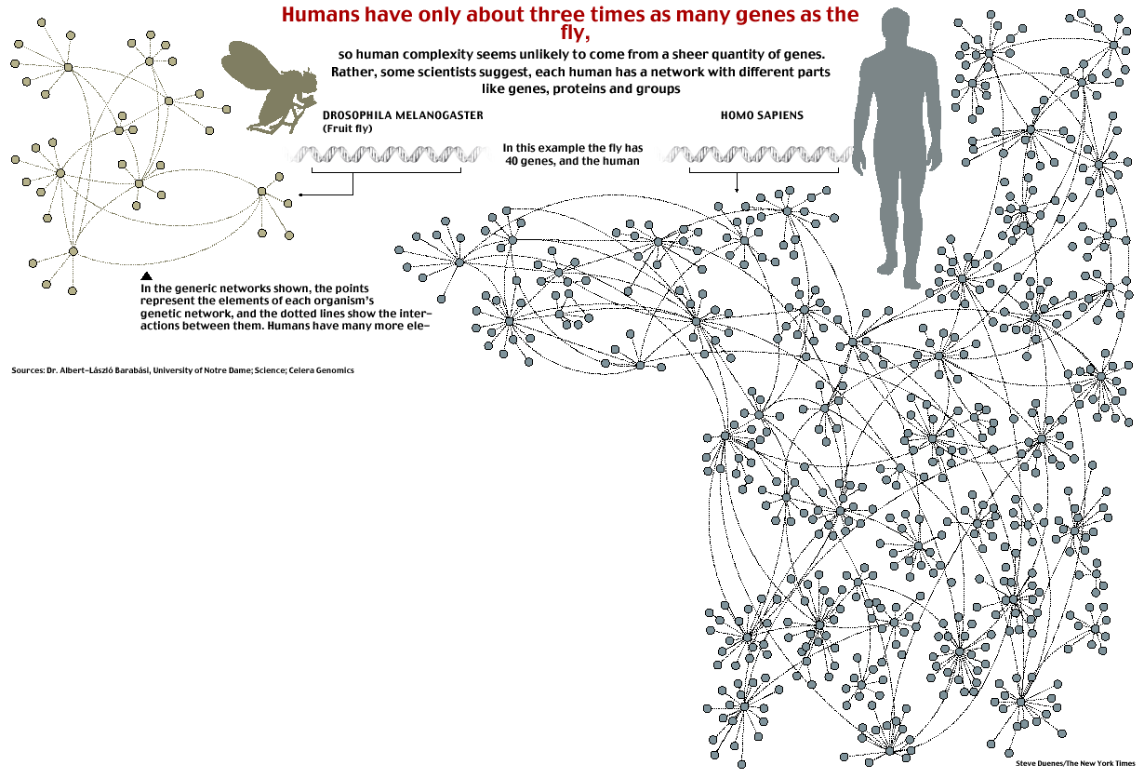
New York Times
Complex systems
Made of many non-identical elements connected by diverse interactions.
NETWORK

Slide 54
“Natural” Networks and Universality
Consider many kinds of networks:
social, technological, business, economic, content,…
These networks tend to share certain informal properties:
large scale; continual growth
distributed, organic growth: vertices “decide” who to link to
interaction restricted to links
mixture of local and long-distance connections
abstract notions of distance: geographical, content, social,…

Slide 55
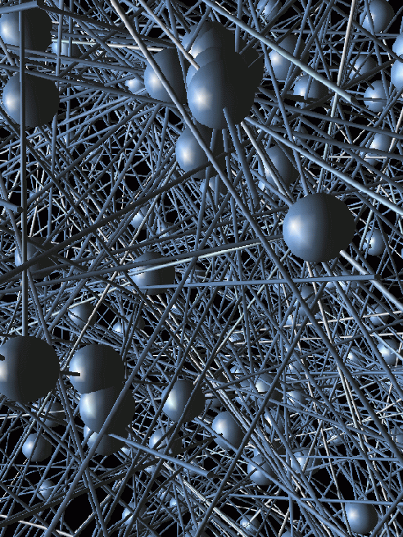




Bacon-map
Rod Steiger
Kevin Bacon
Donald Pleasence
Martin Sheen

Slide 56
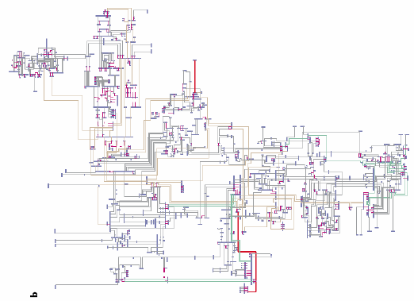
New York State Power Grid
Vertices: generators and substations
Edges: high-voltage power transmission lines and transformers
Line thickness and color indicate the voltage level
Red 765 kV, 500 kV; brown 345 kV; green 230 kV; grey 138 kV

Slide 57
Science Citation Index
25
Nodes: papers Links: citations
Witten-Sander
PRL 1981
1736 PRL papers (1988)
2212
(S. Redner, 1998)

Slide 58
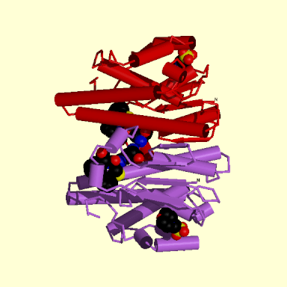
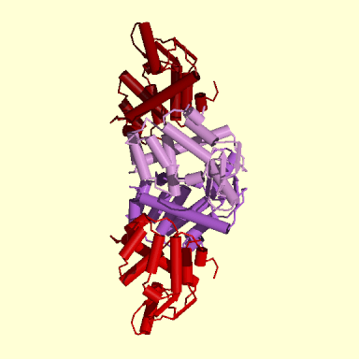
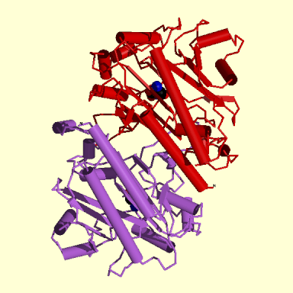
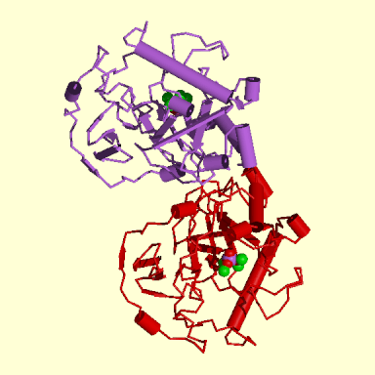
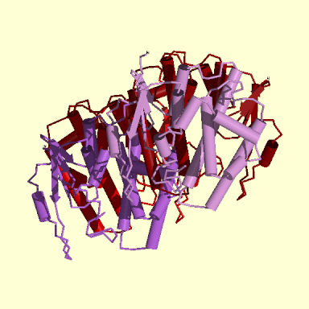
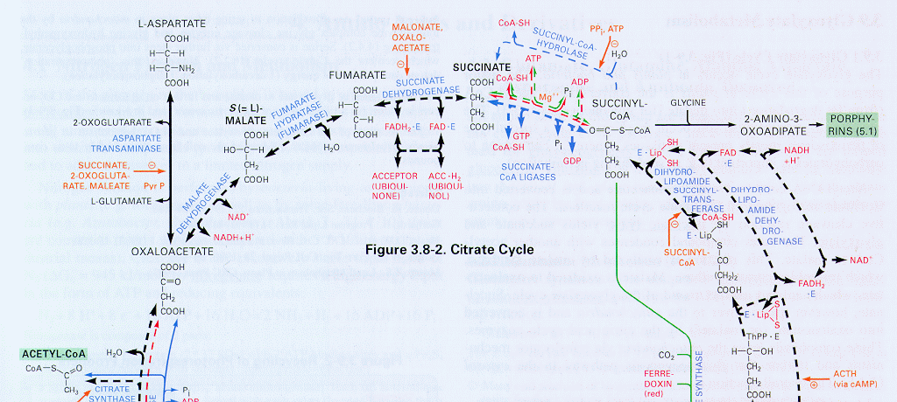
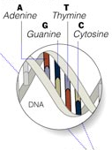

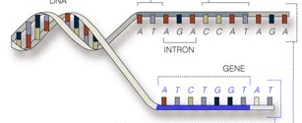
Bio-Map
GENOME
protein-gene interactions
PROTEOME
protein-protein interactions
METABOLISM
Bio-chemical reactions
Citrate Cycle

